Slide 1
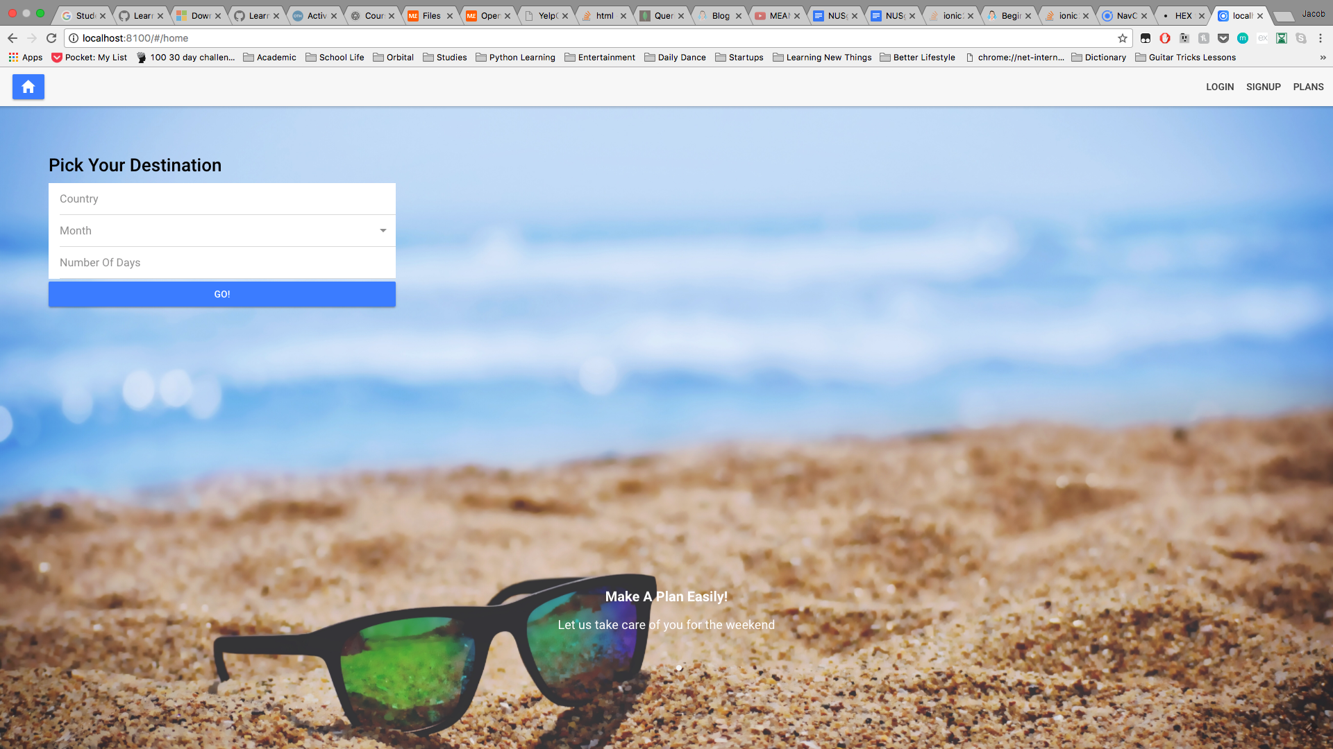

Slide 2
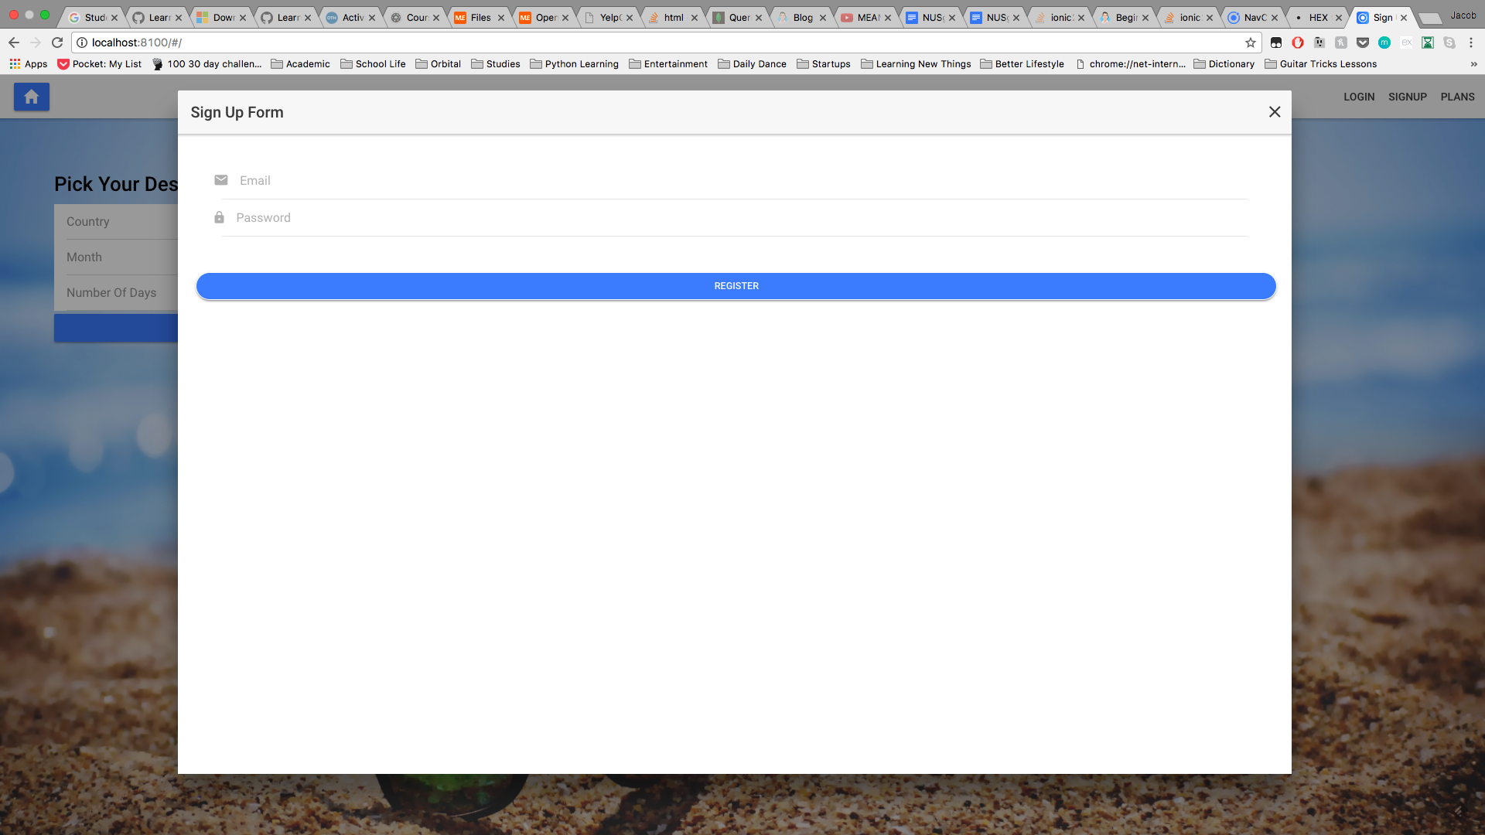

Slide 3
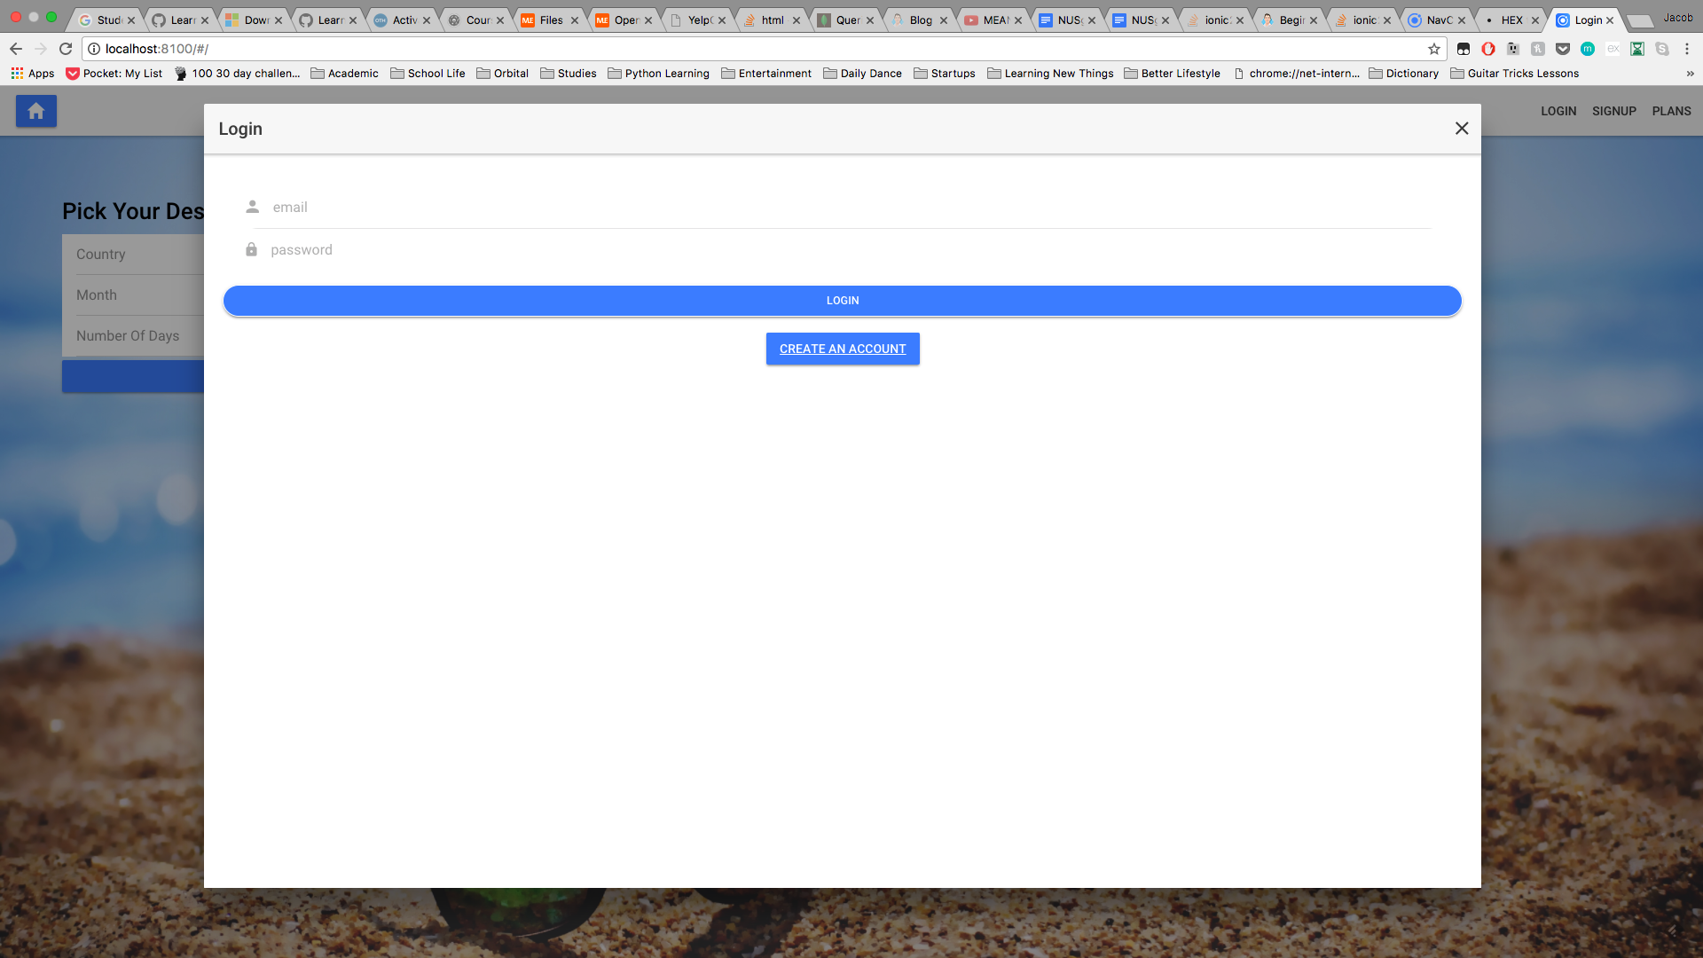

Slide 4
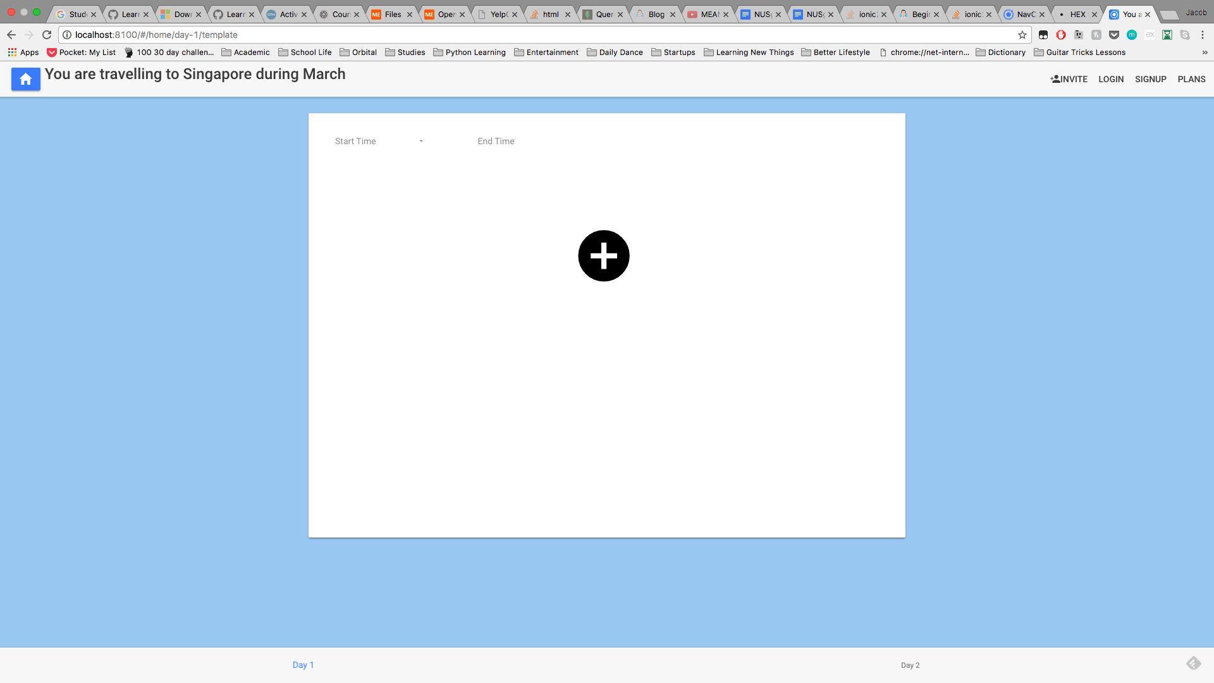

Slide 5
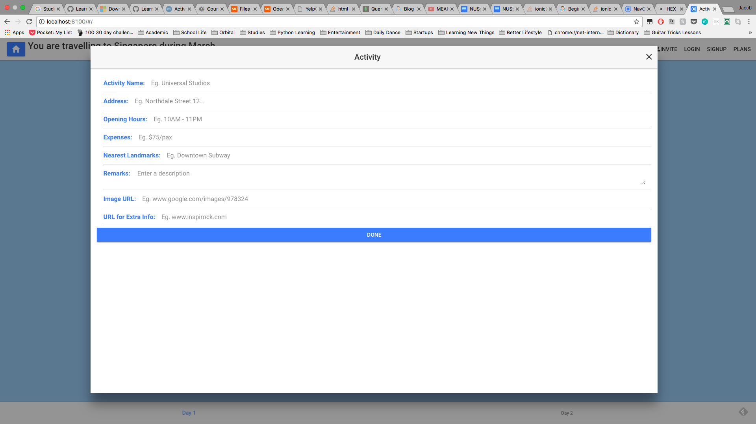

Slide 6
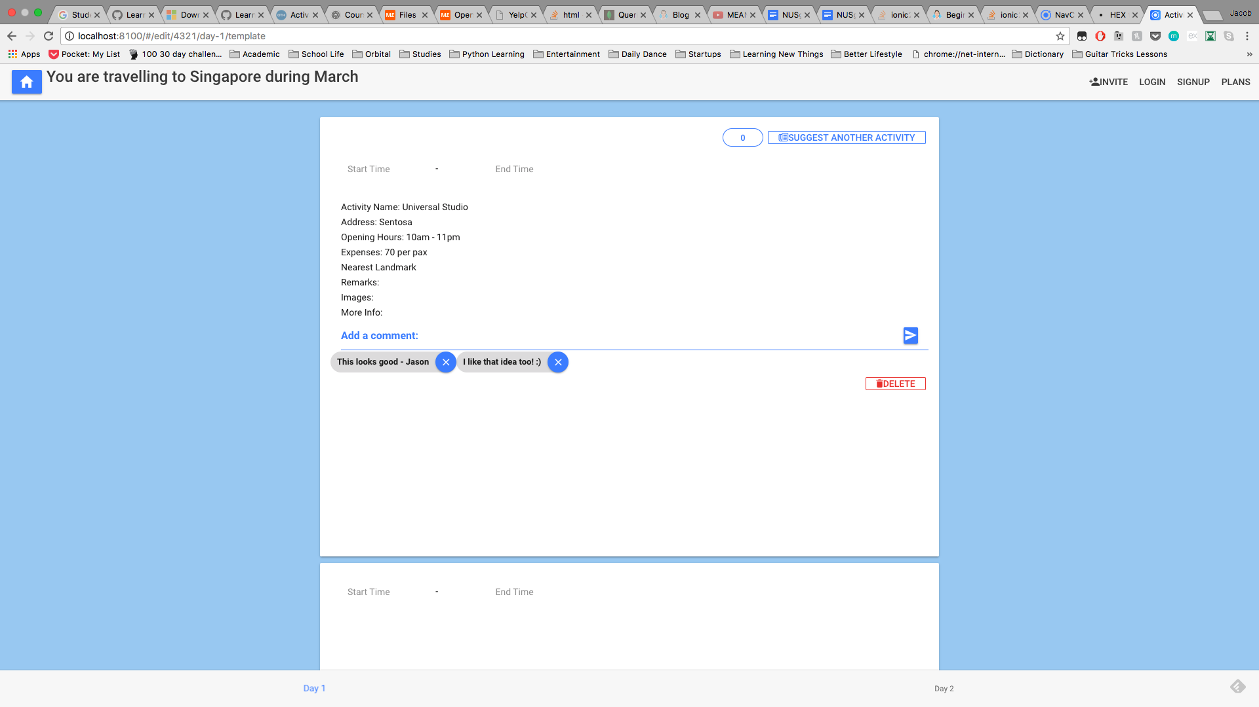

Slide 7
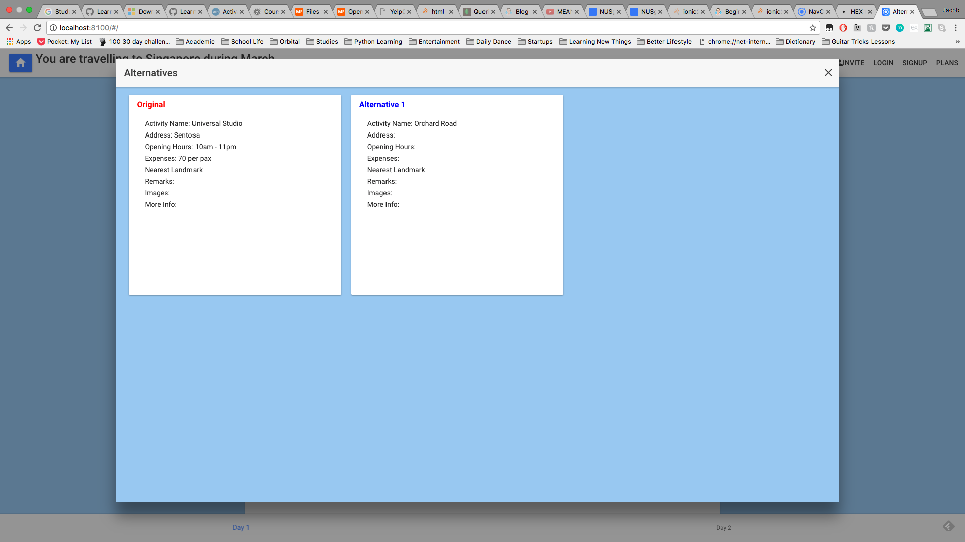

Slide 8
Design Suggestions
Top 5 screen/interaction services we need
Slide 4: the itinerary planning page looks really plain and we are not sure how to design it better. If possible, we would like side columns to show more details about the trip to others like (who is going on the trip, who is free, where to stay, how to get there etc!)
Slide 1: we wanted the home page to be simple but it seems a bit disproportionate at the moment, how do we improve on this?
Slide 5: when adding an activity for the itinerary, it seems too plain and we are not sure what way to incorporate to make it nicer…
Slide 7: main collaboration part for people to interact more… but how? We are thinking where to add the “like” button or how to make it more user friendly?
Slide 6: after adding the activity, it seems a bit plain and not really very comprehensive? How should we play around with the fonts or padding?

Slide 9
Colors we have used so far
Buttons: #488aff
Background: #A4CFF1
Color for tabs: white
Fonts: black
We are trying to go the minimal color scheme style but I think we should have one more color to substantiate our website? Do you have any suggestions?

Slide 10
General comments about the sample screens
Please read the notes section for details

Slide 11
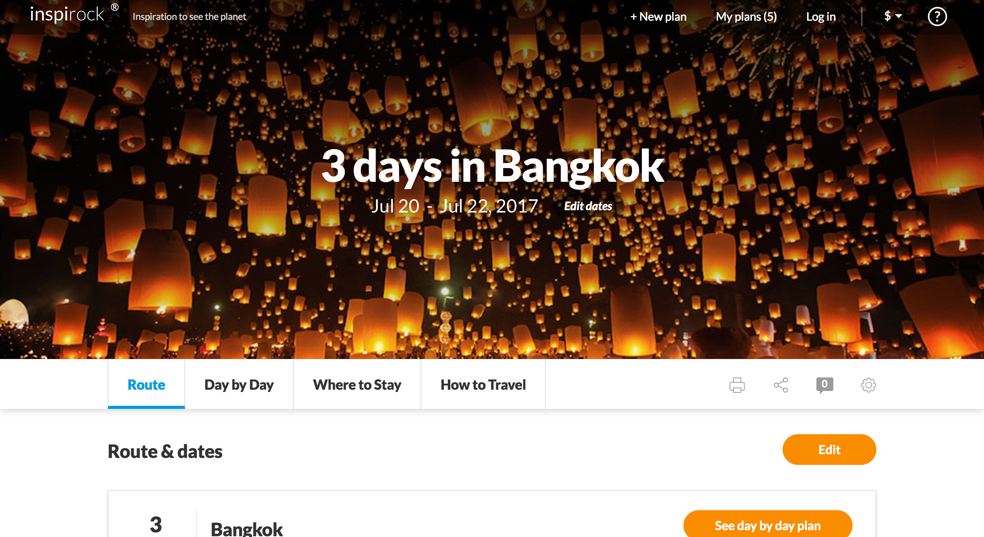
Sample Itinerary planning page
Notes:
It will be good to show more info and make it more user friendly as shown

Slide 12
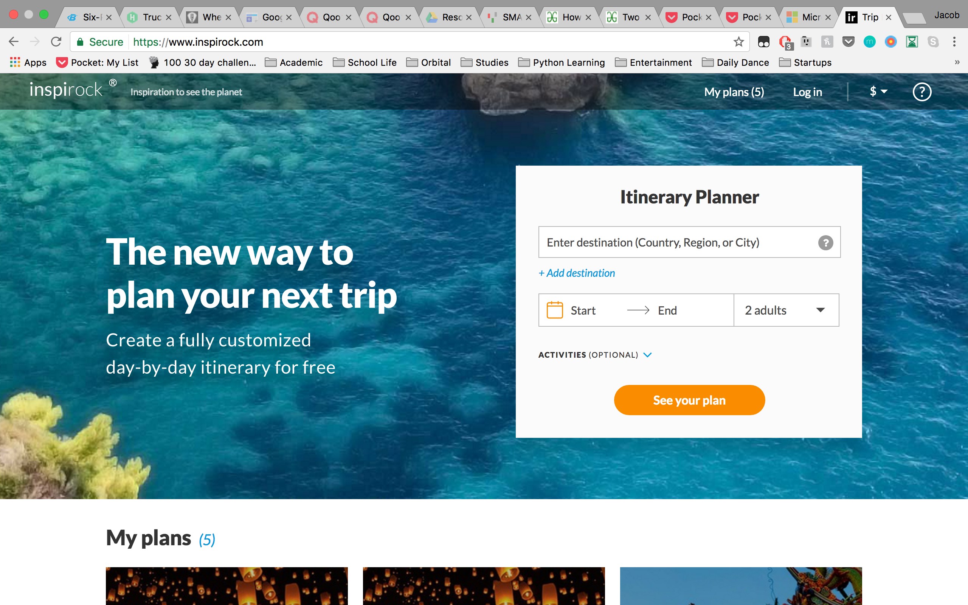
Sample destination page idea

Slide 13
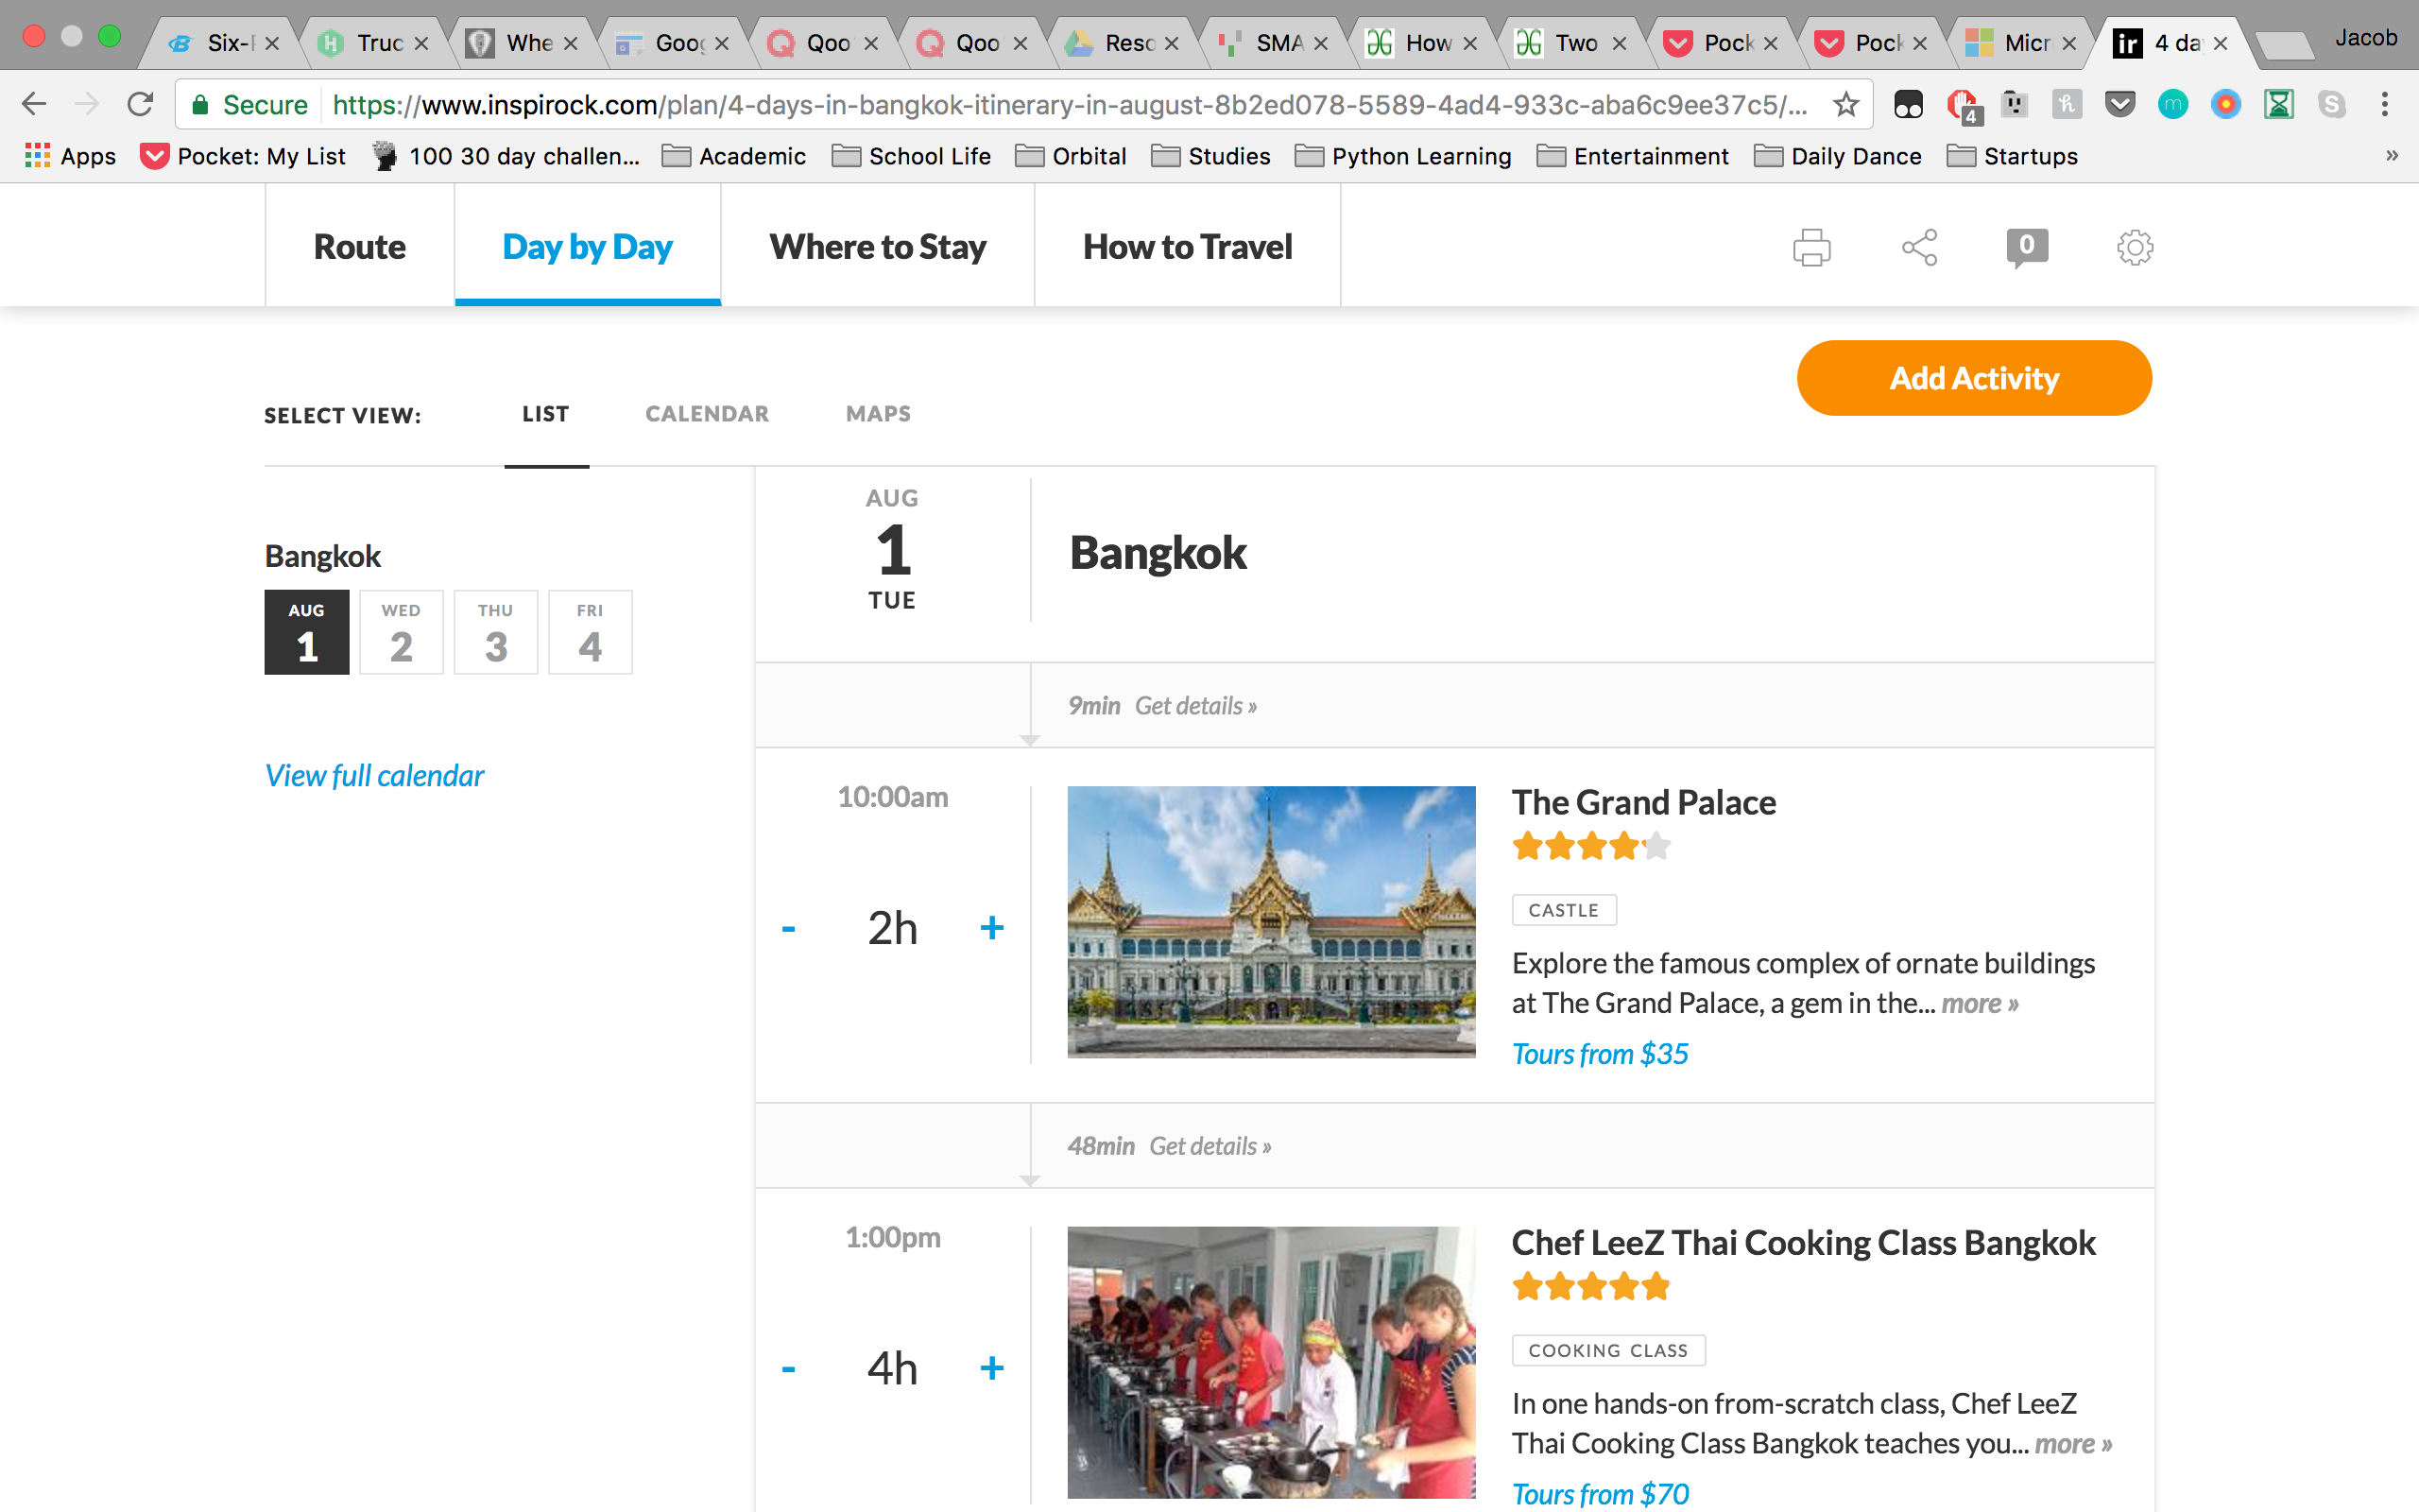
Sample Activity page
Notes:
We probably wont be so interactive as we don’t have images etc but we hope to achieve something like this for our website,
Minimal color scheme yet clear and concise and user friendly

Slide 14
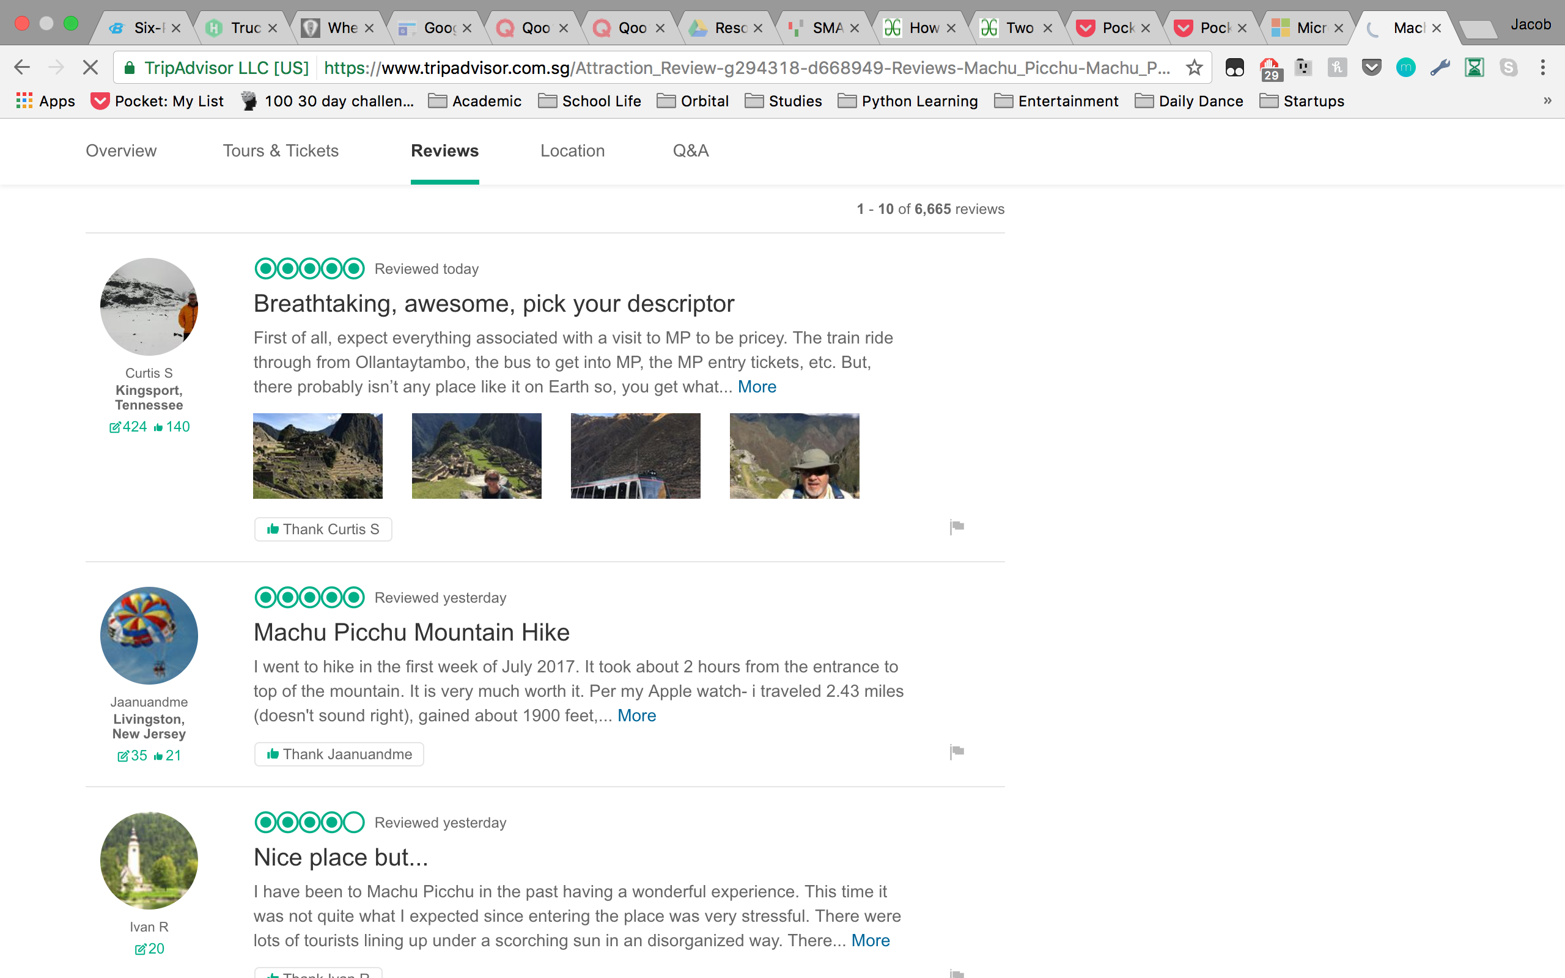
Sample interaction page

Slide 15
Deadline
At the rate we are going, we probably need to ask for one week extension so that we can really focus and concentrate on improving it after our CS2010 finals
As you know, we have certain problems which we not sure how to edit so it’ll be good that if you can tell us ideas and things to change earlier so that we can edit the user interface to make it better first!
Hopefully by this Friday which is 21st July…
If it is too much to ask, then 23rd July will do also!

Slide 16
Thank You Candiie!!!

